Slide 1
JavaScript, Web Frameworks and Visuals
BDAT 1004
Week 8

Slide 2

Announcements
50% of the class is completed!
We have covered most of the “tough” material
Problem Set 3 will be up next week and do last day of class
Don’t forget this weeks quiz!
This lecture has a tutorial but no exercises
Changes to the Syllabus

Slide 3
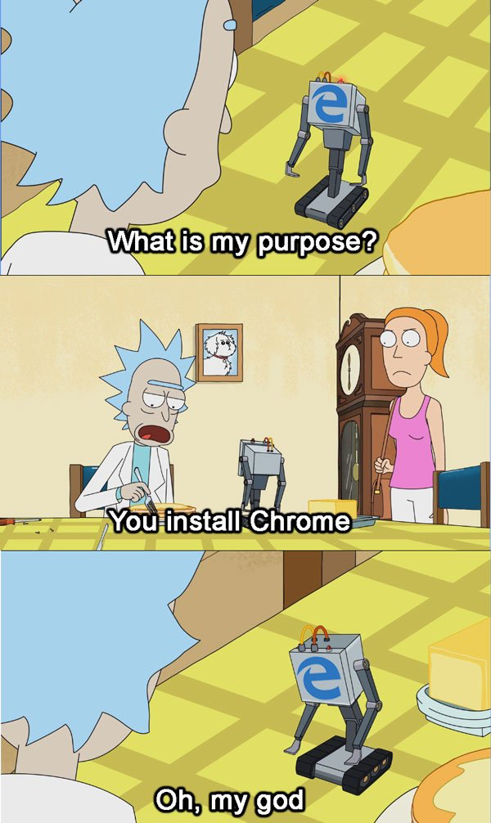
JS Browser Console
All txt files on blackboard change to HTML
I recommend using Chrome or FireFox
However this can be done using any web browser

Slide 4

JavaScript
A high-level, interpreted programming language. It is a language which is also characterized as dynamic, weakly typed, prototype-based and multi-paradigm
Alongside HTML and CSS, JavaScript is one of the three core technologies of the World Wide Web. JavaScript enables interactive web pages and thus is an essential part of web applications
The vast majority of websites use it, and all major web browsers have a dedicated JavaScript engine to execute it

Slide 5
JavaScript Coding Conventions
Coding conventions are style guidelines for programming. They typically cover:
Naming and declaration rules for variables and functions.
Rules for the use of white space, indentation, and comments.
Programming practices and principles
Coding conventions secure quality:
Improves code readability
Make code maintenance easier
Coding conventions can be documented rules for teams to follow, or just be your individual coding practice.

Slide 6
JavaScript Coding Conventions
Variable Names
camelCase for identifier names (variables and functions).
All names start with a letter.
Spaces Around Operators
Always put spaces around operators ( = + - * / ), and after commas:
Code Indentation
Always use 4 spaces for indentation of code blocks:
function toCelsius(fahrenheit) { return (5 / 9) * (fahrenheit - 32); }

Slide 7
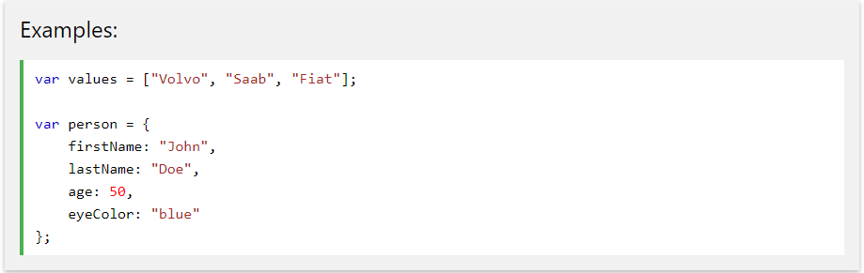
JavaScript Coding Conventions
Statement Rules
General rules for simple statements:
Always end a simple statement with a semicolon.

Slide 8
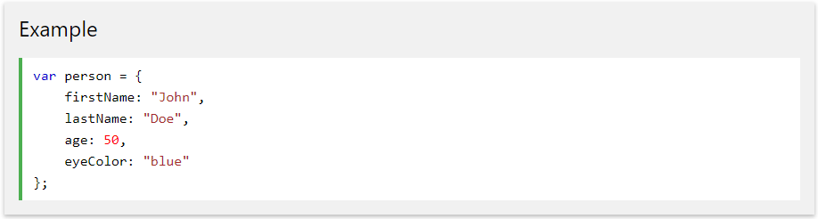
JavaScript Coding Conventions
Object Rules
General rules for object definitions:
Place the opening bracket on the same line as the object name.
Use colon plus one space between each property and its value.
Use quotes around string values, not around numeric values.
Do not add a comma after the last property-value pair.
Place the closing bracket on a new line, without leading spaces.
Always end an object definition with a semicolon.

Slide 9
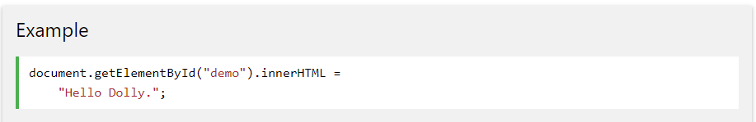
JavaScript Coding Conventions
Line Length < 80
For readability, avoid lines longer than 80 characters.
If a JavaScript statement does not fit on one line, the best place to break it, is after an operator or a comma.

Slide 10
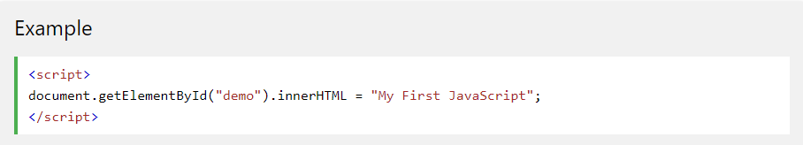
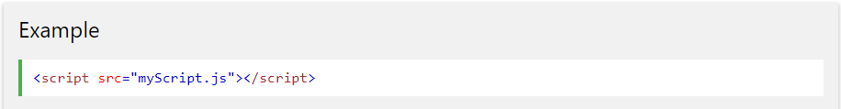
JavaScript Where To
The <script> Tag
In HTML, JavaScript code must be inserted between <script> and </script> tags.
External JavaScript
Scripts can also be placed in external files

Slide 11
JavaScript Variables
All JavaScript variables must be identified with unique names.
These unique names are called identifiers.
Identifiers can be short names (like x and y) or more descriptive names (age, sum, totalVolume).
The general rules for constructing names for variables (unique identifiers) are:
Names can contain letters, digits, underscores, and dollar signs.
Names must begin with a letter
Names can also begin with $ and _ (but we will not use it in this tutorial)
Names are case sensitive (y and Y are different variables)
Reserved words (like JavaScript keywords) cannot be used as names
JavaScript Identifiers are case-sensitive

Slide 12
JavaScript Variables
Declaring (Creating) JavaScript Variables
Creating a variable in JavaScript is called "declaring" a variable.
You declare a JavaScript variable with the var keyword:
After the declaration, the variable has no value. (Technically it has the value of undefined)
To assign a value to the variable, use the equal sign:
You can also assign a value to the variable when you declare it:

Slide 13
JavaScript Arithmetic Operators
Operator | Description
+ | Addition
- | Subtraction
* | Multiplication
/ | Division
% | Modulus (Division Remainder)
++ | Increment
-- | Decrement

Slide 14
JavaScript Assignment Operators
Operator | Example | Same As
= | x = y | x = y
+= | x += y | x = x + y
-= | x -= y | x = x - y
*= | x *= y | x = x * y
/= | x /= y | x = x / y
%= | x %= y | x = x % y
Assignment operators assign values to JavaScript variables.

Slide 15
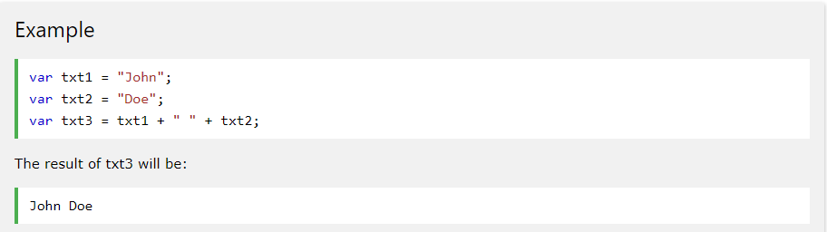
JavaScript String Operators
The + operator can also be used to add (concatenate) strings.

Slide 16
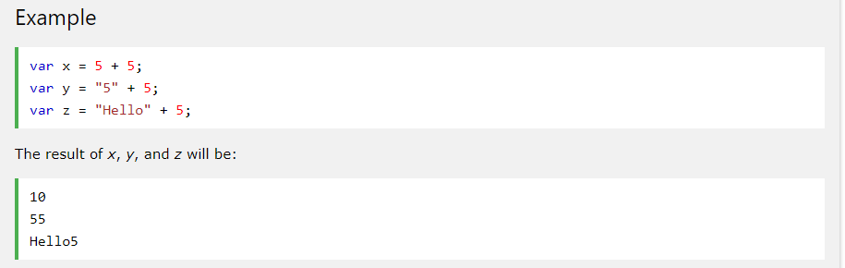
Adding Strings and Numbers
Adding two numbers, will return the sum, but adding a number and a string will return a string:

Slide 17
JavaScript Comparison Operators
Operator | Description
== | equal to
=== | equal value and equal type
!= | not equal
!== | not equal value or not equal type
> | greater than
< | less than
>= | greater than or equal to
<= | less than or equal to
? | ternary operator

Slide 18
JavaScript Logical Operators
Operator | Description
&& | logical and
|| | logical or
! | logical not

Slide 19
JavaScript Bitwise Operators
Operator | Description | Example | Same as | Result | Decimal
& | AND | 5 & 1 | 0101 & 0001 | 0001 | 1
| | OR | 5 | 1 | 0101 | 0001 | 0101 | 5
~ | NOT | ~ 5 | ~0101 | 1010 | 10
^ | XOR | 5 ^ 1 | 0101 ^ 0001 | 0100 | 4
<< | Zero fill left shift | 5 << 1 | 0101 << 1 | 1010 | 10
>> | Signed right shift | 5 >> 1 | 0101 >> 1 | 0010 | 2
>>> | Zero fill right shift | 5 >>> 1 | 0101 >>> 1 | 0010 | 2

Slide 20
Further Study
JavaScript Tutorial - http://www.w3schools.com/js/default.asp
JavaScript Introduction - https://www.w3schools.com/js/js_intro.asp
JavaScript Best Practices - https://www.w3schools.com/js/js_best_practices.asp...
JavaScript Mistakes - https://www.w3schools.com/js/js_mistakes.asp
JavaScript Versions - https://www.w3schools.com/js/js_versions.asp
JavaScript Performance - https://www.w3schools.com/js/js_performance.asp
JavaScript Hoisting - https://www.w3schools.com/js/js_hoisting.asp

Slide 21
Web Application Frameworks
A web application framework (WAF) is a software framework that is designed to support the development of web applications including web services, web resources, and web APIs.
Web frameworks provide a standard way to build and deploy web applications on the World Wide Web. Web frameworks aim to automate the overhead associated with common activities performed in web development.
For example, many web frameworks provide libraries for database access, templating frameworks, and session management, and they often promote code reuse

Slide 22
Web Application Frameworks
There are hundreds of different frames works, most languages have multiple frameworks to work with. Some frameworks you may be familiar with are React JS (used by facebook) Angular JS (Netflix) Django (Instangram) and Ruby on Rails (Twitter)
Since we mainly work with Python we will be covering Flask (a light weight version Django).
However you are more then welcome to choose any framework you wish for your final project

Slide 23
Flask
Microframework for Python
Designed for expansion
Includes only web server and templating engine
Easy to add new functionality via extensions

Slide 24
Virtual Environment
A virtual environment is a tool that helps to keep dependencies required by different projects separate by creating isolated python virtual environments for them.
Imagine a scenario where you are working on two web based python projects and one of them uses a Django 1.9 and the other uses Django 1.10 and so on. Virtual environment can be really useful to maintain dependencies of both the projects.

Slide 25
Virtual Environment
By default, every project on your system will use these same directories to store and retrieve site packages (third party libraries).
How does this matter? Now, in the above example of two projects, you have two versions of Django. This is a real problem for Python since it can’t differentiate between versions in the “site-packages” directory. So both v1.9 and v1.10 would reside in the same directory with the same name.
This is where virtual environments come into play. To solve this problem, we just need to create two separate virtual environments for both the projects.
The great thing about this is that there are no limits to the number of environments you can have since they’re just directories containing a few scripts.

Slide 26
Getting Started
Anaconda already comes with Flask but we should set up a virtual environment
What virtualenv does is create a sandbox environment for you so you can install whatever python libraries you want without affecting anything else on your computer.
When you delete that virtual environment, all those libraries go away like it never happened.
This will make it much easier when you migrate your app to the cloud
Go to the anaconda navigator RUN AS ADMIN
Conda install virtualenv

Slide 27
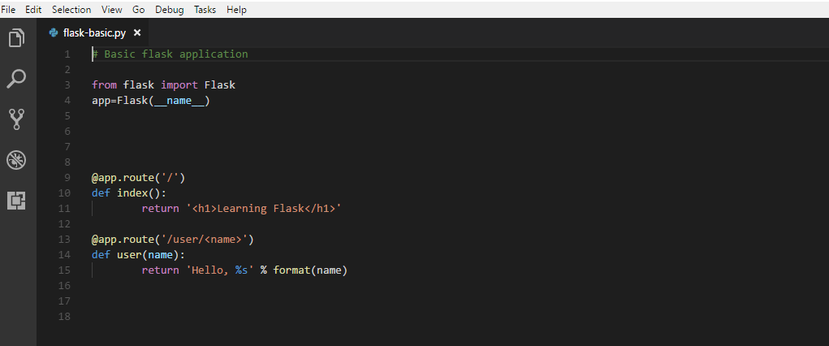
Building a basic web app

Slide 28
Building a basic web app
The first section creates the Flask application. Flask will run on port 5,000 by default
but it still needs to know what to do when a request comes in, so we can jump right into defining routes.
In the first route, you can see the basic structure of the route definition. The definition uses a decorator with the at sign to specify the route being defined. The slash means that Flask will serve this page from the root URL of the server. It will be served at local host colon 5,000 slash.
Next, a function is defined called index which returns an HTML h1 element of learning Flask.
The second route is more interesting. We're defining a variable based on the second part of the URL defined in using angle brackets. So when this URL is visited, the response will have that part of the path included as a variable for our function to work with.
The function here is named user, and the name is passed along from that path variable. Note that we're using Python formatting to create this string along with the format function from the templating engine.

Slide 29
Running the application
Head back to the anaconda prompt
Change the directory to where your application and requirements are
Set up your virtual environment here by typing:
virtualenv venv
Then we need to activate the environment:
venv\Scripts\activate
Then we install the requirements
pip install –r requirements.txt
Set FLASK_APP=flask-basic.py

Slide 30


Bootstrap
Bootstrap is a free and open-source CSS framework directed at responsive, mobile-first front-end web development.
It contains CSS- and JavaScript-based design templates for typography, forms, buttons, navigation and other interface components
Bootstrap is a component of the Flask library and can be integrated into your app for a better appearance

Slide 31
Charts
Charts are an excellent way to visualize data on your web application.
There are many add ons that can be integrated into flask to visualize your analysis
Such as Google Charts, Chart.js and Chartis.js
Most chart APIs require some cut and paste javascript and due to this there needs to be 2 parts to your python application, the main app and the HTML templates
I will show you a video tutorial on Google Charts

Slide 32
Google Charts
The Google Chart API is an interactive Web service (now deprecated) that creates graphical charts from user-supplied data.
Google servers create a PNG image of a chart from data and formatting parameters specified by a user's HTTP request.
The service supports a wide variety of chart information and formatting. Users may conveniently embed these charts in a Web page by using a simple image tag.

Slide 33
Using Charts
Set Up
First let’s set up a file directory
Create
Create a project folder with a project name, I named mine flaskCharts
Create
Inside this project folder create 2 more folders one called “static” and one called “templates”
Open
Now open Visual Studio Code (or whatever text editor you prefer)

Slide 34
Configure Flask
Create the below app.py script(py is the extension to indicate Python script) where we import the flask module. This file should be created under the project root directory. Notice how we create flask instance.
from flask import Flask
app = Flask(__name__)

Slide 35
Configuring URLs
Next, we will create main.py script that will define the URI and render a template file for displaying data on Google pie chart.
Ideally the data should come from database or any other source and a chart should be generated based on real data. But for example purpose, here we are hard-coding the data to be displayed on pie chart.
We use http method GET for displaying view. By default http method is GET if you do not specify http method.
We use render_template function from flask to show the view. We pass the data as an argument to the render_template function.

Slide 36
View – Template File
In templates directory under the project’s root directory, create a template file pie-chart.html with the content html file on Black Board.
Now we will add Google chart API to display our data on chart. We will iterate dictionary items to build the pie chart.
We are also checking whether data is string or not. If the data type is string then we quote around it otherwise we simply put the integer value.
We configure chart options using options array with title and whether the pie chart should be rendered as 3D (is3D = true) or not (is3D = false) . By default pie chart is not rendered as 3D (is3D = false) .
https://developers.google.com/chart/interactive/docs/gallery/piechart

Slide 37
Running and Testing the Application
Now navigate to the project’s root directory and execute the command python main.py as shown in the below image, your server will start on default port 5000.
If you want to change the port then you can change the line app.run() to app.run(port=50001), where 5001 is the new port.
Hit the URL http://localhost:5000/google-charts/pie-chart to open the home page

